Slide 1
Self Driving Car Simulation using Machine Learning
Review 2
Made by: Suyash Gupta

Slide 2
Behavioral Cloning
Behavioral cloning is a method by which human subcognitive skills can be captured and reproduced in a computer program. As the human subject performs the skill, his or her actions are recorded along with the situation that gave rise to the action. A log of these records is used as input to a learning program. The learning program outputs a set of rules that reproduce the skilled behavior. This method can be used to construct automatic control systems for complex tasks for which classical control theory is inadequate. It can also be used for training

Slide 3
Methodology Adapted
Collect training data by moving the car along the track and collecting the images of the track and the steering angle at that particular instance of time.
Performing preimage processing on these images to get the useful region of interest.
Performing Image Augmentation
Balance the image data so that the car does not become biased to steer in a particular direction.
Defining the Neural Network structure for training the simulator.
Tuning the various aspects of the Neural Network in order to train the car.
Establishing a connection between the simulator and the Neural Network model.
Testing and Validating the movement of the car according to the trained Neural Network.

Slide 4
Data Collection
The car in the simulator is driven around the track. The car is provided with three cameras which provide a three different views of the track in front of the car from left, centre and right angles. The simulator provides the option of recording the image data as you move around the track along with the current steering angle, speed, throttle and braking data. Images are saved in the .jpeg format and the other details and parameters are saved in a .csv file.
Since the training track is in the form of a circuit, the data collected gets biased towards a particular angle direction which is not good for the training process. So in order to tackle such situation, we drove the car on the circuit in both the directions in order to balance the data.

Slide 5
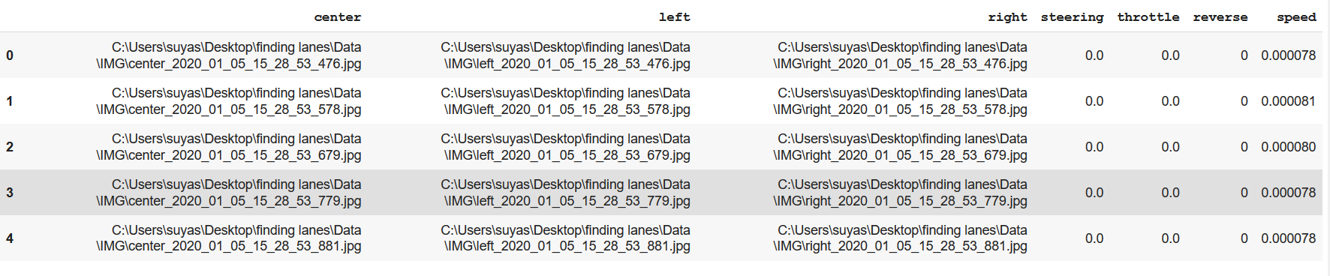
CSV File
The log file contains the data regarding the different parameters during the data collection process in the form of following csv file.

Slide 6
Challenges for Data Collection Process
Since the training track seems to be biased towards a particular direction turn, I collected the data moving around the track in both the directions in order to prevent biasing of model.
In order to make the car to get back on track in case it gets close towards the edges, we need to collect instances of car reviving back on track.
We need to remove few images with zero steering angle in order to prevent the model becoming biased to moving in a straight line.

Slide 7
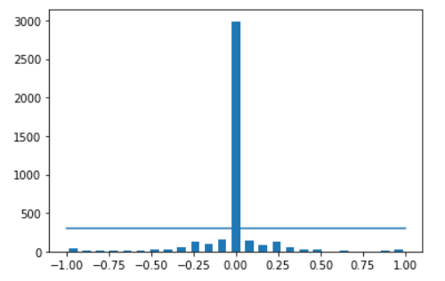
Histogram depicting the number of images for different steering angles

Slide 8
Image Augmentation Techniques
To build a powerful image classifier using very little training data, image augmentation is usually required to boost the performance of deep networks.
Image augmentation artificially creates training images through different ways of processing or combination of multiple processing, such as random rotation, shifts, shear and flips, etc.Augmentation has been applied only to the Training set as it helps your model to generalize to new data.
Zooming
Brightness Alteration
Image Panning
Image Flipping

Slide 9
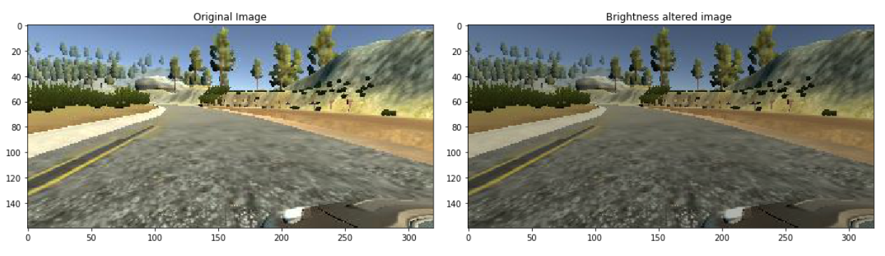
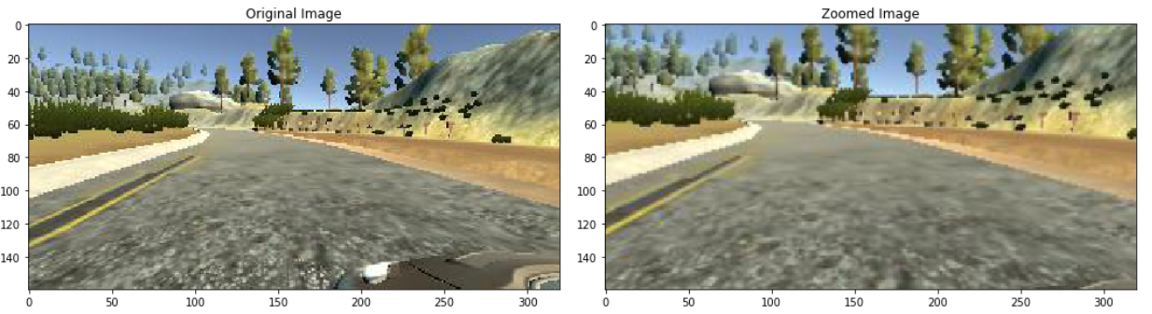
Brightness Alteration
Zooming
The image brightness is altered so as to make the neural network train on images that have different brightness levels as in the real world scenario, shadows are encountered on daily basis on the roads. The image pixel intensities are multiplied by a factor of 0.2 to 1.2 in order to get different images with altered brightness.
The dataset images were zoomed in by 30% in order to remove the extra no useful part of images containing the surroundings data and the hood of the car. It allows us to focus on the most useful part of the image which is the track and the boundaries.

Slide 10
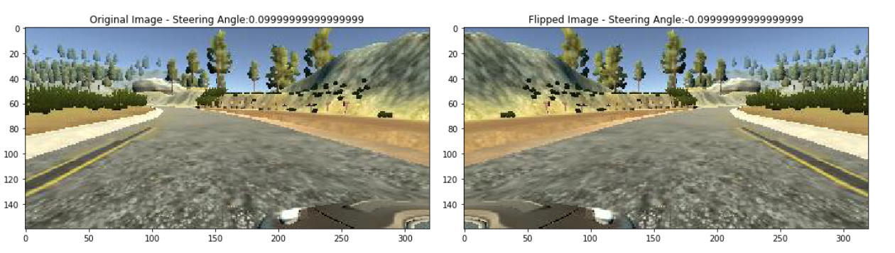
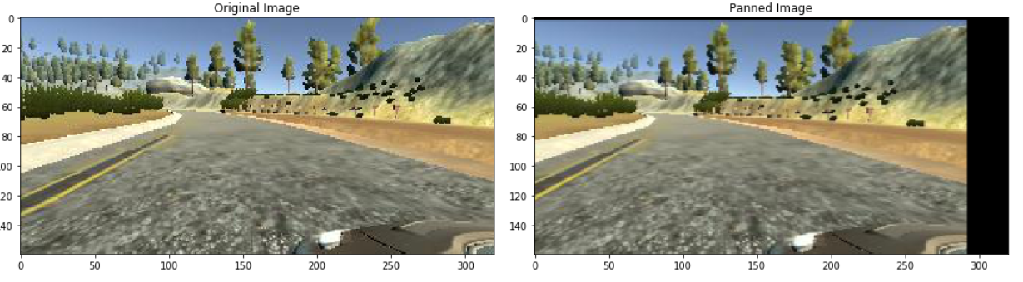
Flipped Image
Panned Image
A flipped image or turned around image, the more conventional term, is a static or moving image that is created by a mirror-inversion of a unique over a horizontal pivot (a floundered image is mirrored over the vertical axis). The steering angle associated with the particular image in the dataset is also flipped so as to balance it with same degree of left and right steering angles.
Panning alludes to the horizontal repositioning of a digital image on the output display device. The digital image might be quickly repositioned by duplicating the pixel values to new (x,y) areas to deliver the impact of panning. In video innovation, panning alludes to the horizontal looking of an image more extensive than the display.

Slide 11
Image Preprocessing
Cropping the image in order to remove the non-essential parts in the input image.
Converting the image from RGB(Red,Green,Blue) to YUV
Applying the Gaussian Blur filter on the image
Resizing the image to an appropriate size (here 200x66)
Normalizing the image by dividing by 255

Slide 12
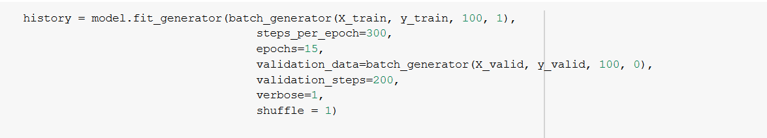
Training
Adam and Stochastic Gradient Descent are the weight optimization algorithms which I used to train the Models according to the results I got.
Number of epochs range from 10 to 30 epochs according to the model.
Batch Generator function has been called in order to augment the images on the fly so that less space is used up by the training images. Batch Generator is only called for the training set.
verbose: Integer. 0, 1, or 2. Verbosity mode. 0 = silent, 1 = progress bar

Slide 13
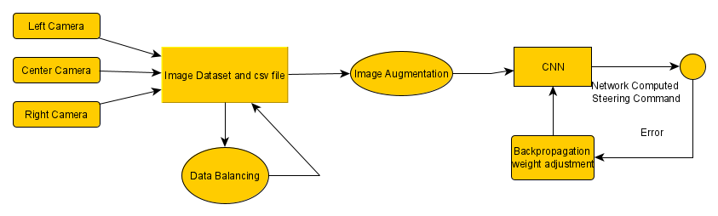
Training Process

Slide 14
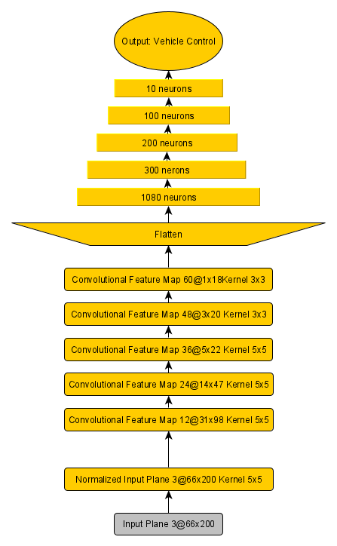
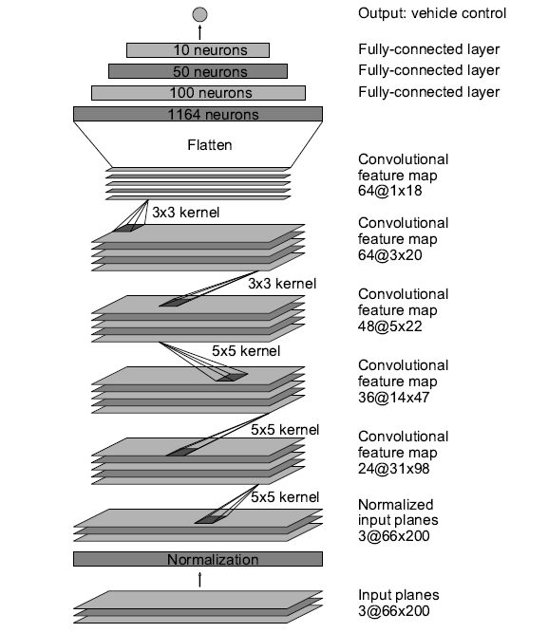
NVIDIA CNN architecture
Proposed CNN architecture

Slide 15
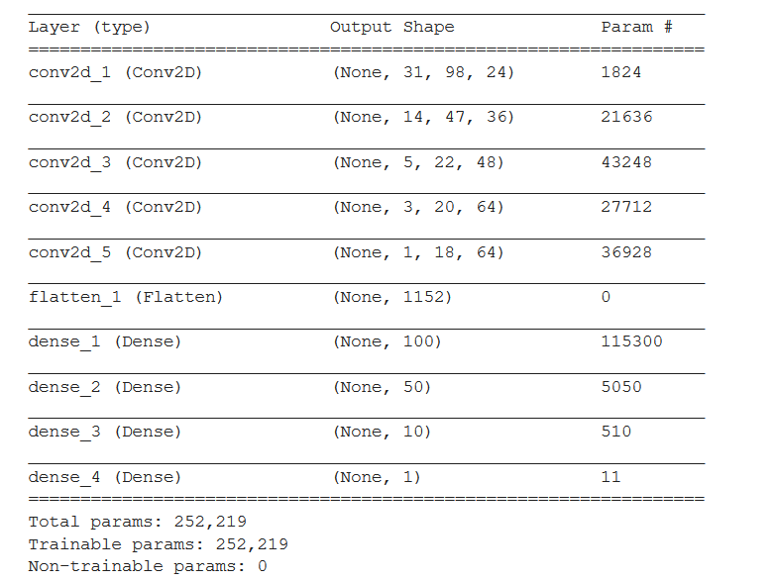
NVIDIA model
There are five Convolutional layers and four Fully Connected layers.
Total No. of Params: 252,219

Slide 16
Changes made to the NVIDIA model
Addition of a Fully connected layer
Addition of a Convolution Layer
Change in the number of neurons in the fully connected layer
Different number of Conv2d filters in each convolution layer
Using Adam weight Optimization Algorithm for training process

Slide 17
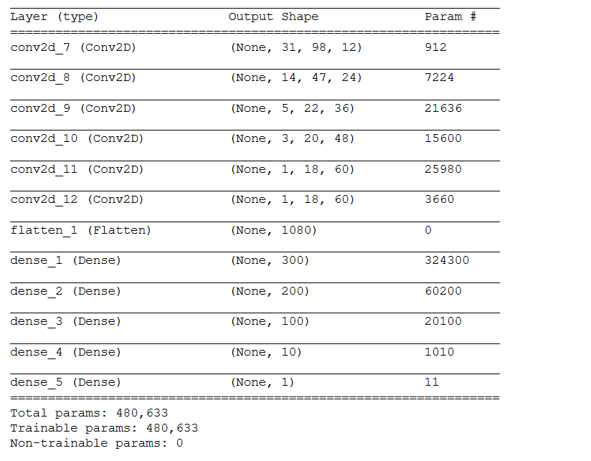
Proposed Model Description
The Model consists of six convolutional layers and five fully connected layers.
Total No. of Params : 478,973

Slide 18
Training the new CNN Model
Epochs: 15
Steps per Epoch: 300
Validation Steps: 200

Slide 19
Hyperparameters that were not useful
Batch Normalization
Pooling Layers
Dropout Layers
ResNet
Different Activation Functions like TanH , Softmax.

Slide 20
ResNet
ResNet, short for Residual Networks is a classic neural network used as a backbone for many computer vision tasks.
The fundamental breakthrough with ResNet was it allowed us to train extremely deep neural networks with 150+layers successfully.
Prior to ResNet training very deep neural networks was difficult due to the problem of vanishing gradients.
ResNet uses skip connection to add the output from an earlier layer to a later layer. This helps it mitigate the vanishing gradient problem

Slide 21
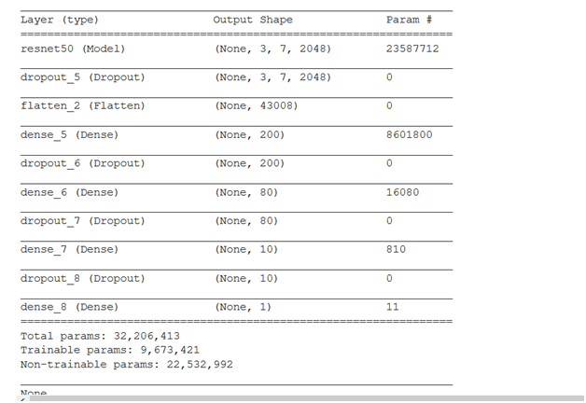
ResNet Model Description
This model uses ResNet50 with 46 layers (4 layers removed in order to customize) with four Fully Connected layers.
Total No. of Params: 32,206,413

Slide 22
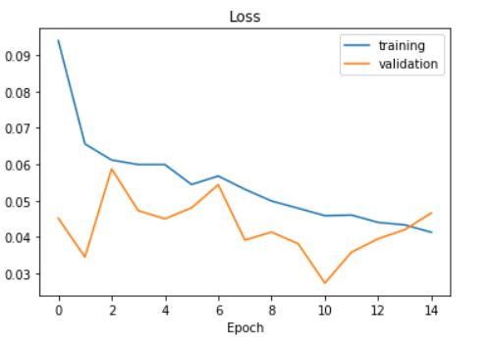
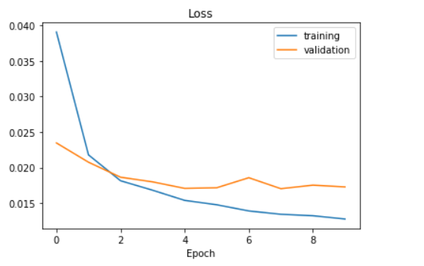
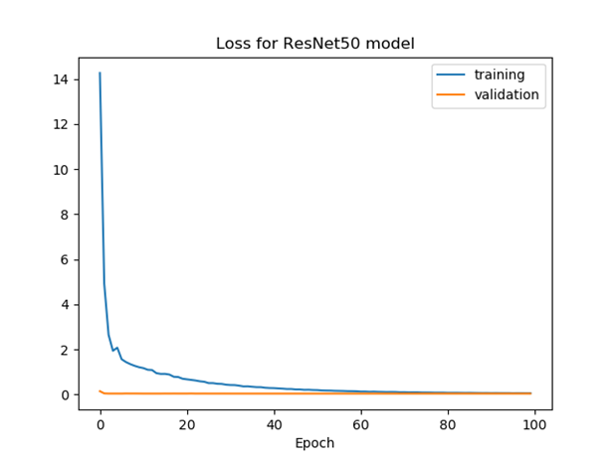
Model Comparison
Validation and Training Loss for ResNet model
Validation and Training Loss for new model
Validation and Training Loss for NVIDIA model

Slide 23
Testing Parameters for Comparison
 | NVIDIA model | Proposed CNN model | ResNet Model
No. of times car crashed | 0 | 0 | 1
No. of times car reaches close to edge | 1 | 4 | 1
Car able to revive its position | 1 | 4 | 0
Car able to finish the track | Yes | Yes | No
Distance covered if crashed | - | - | 150m
Length Of Track : 1.1 Km

Slide 24
Performance Comparison Table
 | Training Loss | Validation Loss | Successful on Simulator
NVIDIA Model | 0.0128 | 0.0173 | Yes
Proposed Model | 0.0413 | 0.0466 | Yes
ResNet | 0.1744 | 0.038 | No

Slide 25
Thank You

